Slide 1
How to diagnose heart failure
Part III
Veeva ID: PH - 5976
Date of preparation: September 2021

Slide 2
“This session is supported by AstraZeneca. The content is intended for Health Care Professionals for medical educational purposes only. Expert opinions of the participating physicians are based on their experience to date.
AstraZeneca does not engage in the promotion of unregistered products or unapproved indications.
Please consult local Prescribing Information for registration product license details.”
Notes:
Please note that this is a non-promotional session and there will be in the discussion off-label topics and it is upon the clinicians discretion according to their clinical practice and what benefits their patients based on the guidelines

Slide 3
Diagnosis of HF
Criteria
Diagnosis pathway
Screening for HF
Biomarkers for HF
“This session is supported by AstraZeneca. The content is intended for Health Care Professionals for medical educational purposes only. Expert opinions of the participating physicians are based on their experience to date. AstraZeneca does not engage in the promotion of unregistered products or unapproved indications. Please consult local Prescribing Information for registration product license details.”
HF, heart failure

Slide 4
Diagnosis of heart failure is based on Framingham criteria
Diagnosis of HF requires two major criteria to be met, or one major plus two minor criteria:
Major criteria | Minor criteria
Hepatojugular reflux | Ankle edema
Neck-vein distension (nonsupine position) | Night cough
Increased venous pressure (>16 cm H₂O from right atrium) | Decreased vital capacity by one-third from maximum records
Paroxysmal nocturnal dyspnea | Pleural effusion
Rales in the presence of unexplained dyspnea | Hepatomegaly
Acute pulmonary edema in hospital records | Dyspnea on exertion
A third heart sound (S₃, also known as ventricular gallop) | Tachycardia (heart rate >120 bpm)
Increased circulation time (>24 s from arm to tongue)
Cardiomegaly and pulmonary hilar congestion at radiography or increasing heart size
Autopsy with evidence of pulmonary edema or cardiomegaly
“This session is supported by AstraZeneca. The content is intended for Health Care Professionals for medical educational purposes only. Expert opinions of the participating physicians are based on their experience to date. AstraZeneca does not engage in the promotion of unregistered products or unapproved indications. Please consult local Prescribing Information for registration product license details.”
HF, heart failure
Andersson C, et al. Nat Rev Cardiol 2019;16:687–698

Slide 5
ESC Guidelines for HF diagnosis
Algorithm for diagnosis of HF of nonacute onset
Patient with suspected HFª
(nonacute onset)
prompted by signs and symptoms
Assessment
of natriuretic peptides not routinely
conducted in clinical practice
Assessment of HF probability
Echocardiography
Clinical history:
History of CAD (MI, revascularization)
History of arterial hypertension
Exposition to cardiotoxic drug/radiation
Use of diuretics
Orthopnea/paroxysmal nocturnal dyspnea
Physical examination:
Rales
Bilateral ankle edema
Heart murmur
Jugular venous dilatation
Laterally displaced/broadened apical beat
ECG:
Any abnormality
Natriuretic peptides
NT-proBNP ≥125 pg/mL
BNP ≥35 pg/mL
If HF confirmed (based on all available data):
Determine etiology
and start
appropriate treatment
≥1 present
Yes
No
HF unlikely:
Consider other diagnosis
All absent
Normal^{b,c}
“This session is supported by AstraZeneca. The content is intended for Health Care Professionals for medical educational purposes only. Expert opinions of the participating physicians are based on their experience to date. AstraZeneca does not engage in the promotion of unregistered products or unapproved indications. Please consult local Prescribing Information for registration product license details.”
ªPatient reporting symptoms typical of HF; ^{b}Normal ventricular and atrial volumes and function; ^{c}Consider other causes of elevated natriuretic peptides
BNP, B-type natriuretic peptide; CAD, coronary artery disease; ESC, European Society of Cardiology; HF, heart failure; MI, myocardial infarction; NT-proBNP, N-terminal pro-B-type natriuretic peptide
Adapted from Ponikowski P, et al. Eur Heart J 2016;37:2129–2200

Slide 6
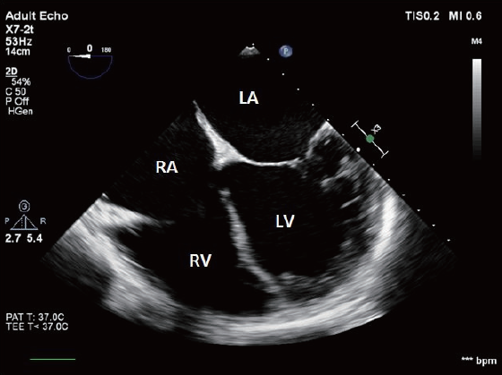
Echocardiography: The standard for characterizing structural and functional changes in HF
Assesses cardiac function, including systolic or diastolic dysfunction¹
Measures LVEF, volumes, and mass, and characterizes structural abnormalities^{1,2}
Can reveal subclinical HF disease and predict risk of cardiovascular events²
Abnormalities in electrical conduction and heart rhythm, such as arrhythmias or LV hypertrophy, can be detected,
and appropriate treatment advised¹
Transesophageal echocardiography can reveal
abnormalities in heart structure and function³
“This session is supported by AstraZeneca. The content is intended for Health Care Professionals for medical educational purposes only. Expert opinions of the participating physicians are based on their experience to date. AstraZeneca does not engage in the promotion of unregistered products or unapproved indications. Please consult local Prescribing Information for registration product license details.”
HF, heart failure, LA, left atrium; LV, left ventricle; LVEF, left ventricular ejection fraction; RA, right atrium; RV, right ventricle
1. McMurray JJV, et al. Eur Heart J 2012;33:1787–1847; 2. Yancy CW, et al. J Am Coll Cardiol 2013;62:e147–e239; 3. Flores AS, et al. J Thorac Dis 2015;7:2139–2150

Slide 7
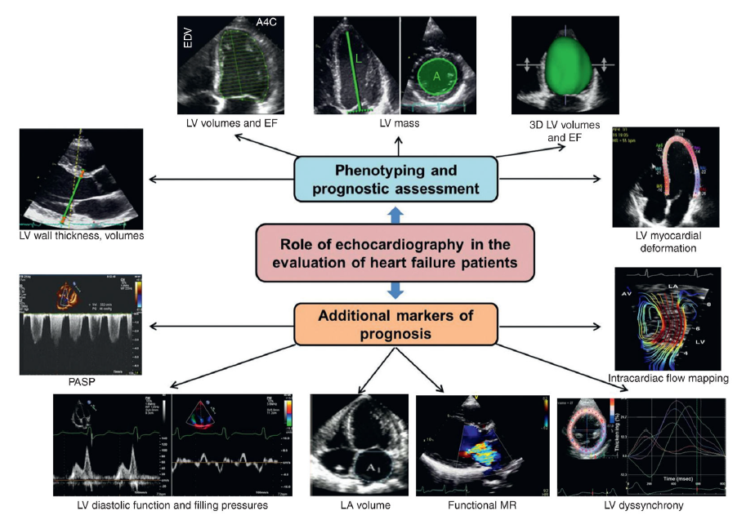
Echocardiography provides a framework for key management decisions and impacts overall prognosis and outcomes
LV volumes
and EF
LV mass
3D LV volumes and EF
Phenotyping and
prognostic assessment
LV wall thickness, volumes
Role of echocardiography
in the evaluation of patients
with heart failure¹
LV myocardial deformation
Additional markers
of prognosis
PASP
Intracardiac flow mapping
LV diastolic function and filling pressures
LA volume
Functional MR
LV dyssynchrony
“This session is supported by AstraZeneca. The content is intended for Health Care Professionals for medical educational purposes only. Expert opinions of the participating physicians are based on their experience to date. AstraZeneca does not engage in the promotion of unregistered products or unapproved indications. Please consult local Prescribing Information for registration product license details.”
EF, ejection fraction; LA, left atrial; LV, left ventricular; MR, mitral regurgitation; PASP, pulmonary artery systolic pressure
Omar AM, et al. Circ Res 2016;119:357–374

Slide 8
The diagnostic criteria for the diagnosis of HF using echocardiography
Clinical relevant threshold values for echocardiographic measurements^{1,2}
LVEF | <60% | Threshold for intervention in chronic severe MR
 | <50% | (1) Indication for AVR in severe AS, severe AR (2) Threshold above which heart failure is classified as ‘heart failure with preserved EF’
 | <40% | Used for diagnosing ‘heart failure with reduced EF’
 | ≤35% | Indication for CRT in appropriately selected patients
 | ≤30–35% | Indication for ICD implantation for primary prevention of sudden cardiac death, depending on functional class and underlying aetiology
 | <30% | Only a class IIb indication for surgery in chronic severe MR
LV wall thickness and mass | Septal wall thickness (cm) Posterior wall thickness (cm) | Normal range (M): 0.6–1.0 [mildly abnormal: 1.1–1.3; moderately abnormal: 1.4–1.6; severely abnormal: >1.6] Normal range (F): 0.6–0.9 [mildly abnormal: 1.0–1.2; moderately abnormal: 1.3–1.5; severely abnormal: >1.5] Normal range (M): 0.6–1.0 [mildly abnormal: 1.1–1.3; moderately abnormal: 1.4–1.6; severely abnormal: >1.6] Normal range (F): 0.6–0.9 [mildly abnormal: 1.0–1.2; moderately abnormal: 1.3–1.5; severely abnormal: >1.5]
 | Normal range and severity cut off (g) | Normal range (M): 88–224 [mildly abnormal: 225–258; moderately abnormal: 259–292; severely abnormal: >292] Normal range (F): 67–162 [mildly abnormal: 163–186; moderately abnormal: 187–210; severely abnormal: >210]
LA volume | >34 mL/m² | Threshold for defining as increased left atrial volume [mildly enlarged: 35–41; moderately enlarged: 42–48; severely enlarged: >48]
Mitral stenosis
Mitral valve area PASP (mm Hg) | ≤1.5 cm² Grading based on severity | Indicates significant MS; is a threshold for intervention in appropriately selected patients Mild: <30; moderate: 30–50; severe: >50
Aortic stenosis
Aortic valve area | <1 cm² | Used for diagnosing severe AS; threshold for intervention in appropriately selected patients
LV diastolic function
Mitral E/A ratio | >2 | Generally indicates restrictive mitral filling pattern with raised left atrial pressure
Mitral E/e’ average | >14 | Generally indicates raised left atrial pressure
“This session is supported by AstraZeneca. The content is intended for Health Care Professionals for medical educational purposes only. Expert opinions of the participating physicians are based on their experience to date. AstraZeneca does not engage in the promotion of unregistered products or unapproved indications. Please consult local Prescribing Information for registration product license details.”
AR, aortic regurgitation; AS, aortic stenosis; AVR, aortic valve replacement; CRT, cardiac resynchronization therapy; e’, mitral annular early diastolic velocity; E, mitral inflow early diastolic velocity; EF, ejection fraction;
ICD, implantable cardioverter defibrillator; LA, left atrial; LV, left ventricular; LVEF, left ventricular ejection fraction; MR, mitral regurgitation; MS, mitral stenosis; PASP, pulmonary artery systolic pressure
1. Bansal M, Sengupta P. Heart 2017;103:1733–1744; 2. The American Society of Echocardiography. The ASE workflow and lab management task force. Available at: https://asecho.org/wp-content/uploads/2018/08/WFTF-Chamber-Quantification-Summary-Doc-Final-July-18.pdf (Accessed April 2021)

Slide 9
BNP and NT-proBNP are key biomarkers for HF detection¹
Testing cardiac biomarkers acts as a primary differential test to determine if further imaging is required²
BNP and NT-proBNP are secreted directly from the LV myocardium in response to end-diastolic wall stress caused
by volume and pressure overloadª
Upper limits of normal^{1,2}
Diagnostic accuracies of natriuretic peptide testing³
Setting | BNP | NT-proBNP
Nonacute | 35 pg/mL | 125 pg/mL
Acute | <100 pg/mL | <300 pg/mL
BNP | NT-proBNP
100 pg/mL: 90% sensitivity 76% specificity 79% positive predictive value 89% negative predictive value | 900 pg/mL: 90% sensitivity 85% specificity 76% positive predictive value 94% negative predictive value
‘Rule out’ level: <50 pg/mL 96% negative predictive value | ‘Rule out’ level: <300 pg/mL 98% negative predictive value
 | Age-specific cutoffs: <50 years: 450 pg/mL 50–75 years: 900 pg/mL >75 years: 1800 pg/mL
Elevated natriuretic peptide levels do not automatically indicate HF, and should
be accompanied with the appropriate
clinical history and imaging tests²
“This session is supported by AstraZeneca. The content is intended for Health Care Professionals for medical educational purposes only. Expert opinions of the participating physicians are based on their experience to date. AstraZeneca does not engage in the promotion of unregistered products or unapproved indications. Please consult local Prescribing Information for registration product license details.”
ªNT-proBNP is an amino-terminal cleavage equivalent of BNP
BNP, B-type natriuretic peptide; HF, heart failure; LV, left ventricle; NT-proBNP, N-terminal pro-B-type natriuretic peptide
1. Magnussen C, Blankenberg S. J Intern Med 2018;283:530–543; 2. Ponikowski P, et al. Eur Heart J 2016;37:2129–2200; 3. Heil B, Tang WH. Cleve Clin J Med 2015;82(12 Suppl 2):S28–S35

Slide 10
BNP levels are indicative of hHF and all-cause mortality
Nelson–Aalen estimate of hHF
stratified by BNP levels
Kaplan–Meier estimate of survival
stratified by BNP levels
1.0
hHF
BNP 250–499
BNP 500–749
BNP 750–999
BNP 1000–1249
BNP 1250–1499
BNP ≥1500
RR (95% CI)ª
1.8 (1.7, 1.9)
2.4 (2.2, 2.5)
2.5 (2.3, 2.8)
3.0 (2.7, 3.3)
2.8 (2.5, 3.1)
3.3 (3.0, 3.5)
1.0
0.8
0.9
0.6
0.8
hHF (events/patient)
Survival
0.4
0.7
Mortality
BNP 250–499
BNP 500–749
BNP 750–999
BNP 1000–1249
BNP 1250–1499
BNP ≥1500
RR (95% CI)ª
1.7 (1.6, 1.8)
2.2 (2.0, 2.3)
2.7 (2.5, 2.9)
2.9 (2.6, 3.2)
3.2 (2.8, 3.5)
3.9 (3.7, 4.2)
0.2
0.6
0.0
0.5
0
3
6
9
12
0
3
6
9
12
Time (months)
Time (months)
No. at risk
BNP 0–249
31492
30855
30185
29476
28766
31492
30855
30185
29476
28766
BNP 250–499
12704
12163
11650
11139
10637
12704
12163
11650
11139
10637
BNP 500–749
6197
5821
5508
5185
4876
6197
5821
5508
5185
4876
BNP 750–999
3529
3262
3031
2808
2614
3529
3262
3031
2808
2614
BNP 1000–1249
2244
2055
1866
1744
1625
2244
2055
1866
1744
1625
BNP 1250–1499
1596
1448
1310
1202
1126
1596
1448
1310
1202
1126
BNP ≥1500
6593
5692
5053
4531
4134
6593
5692
5053
4531
4134
“This session is supported by AstraZeneca. The content is intended for Health Care Professionals for medical educational purposes only. Expert opinions of the participating physicians are based on their experience to date. AstraZeneca does not engage in the promotion of unregistered products or unapproved indications. Please consult local Prescribing Information for registration product license details.”
ªAll RR are compared with 0–249 BNP group and are significantly different than 1; P<0.001
BNP, B-type natriuretic peptide; CI, confidence interval; hHF, hospitalization for heart failure; RR, risk ratio
Zile MR, et al. Clin Cardiol 2020;43:1501–1510

Slide 11
Elevated natriuretic peptide levels are associated with a range of causes
Low values of BNP or NT-proBNP exclude the presence of HF, and high values have a reasonably high positive predictive value for the diagnosis of HF
However, elevated BNP or NT-proBNP have been associated with a wide variety of cardiac and noncardiac causes
Selected causes of elevated natriuretic peptide levels
Cardiac | Noncardiac
HF, including RV syndromes Acute coronary syndrome Heart muscle disease, including LVH Valvular heart disease Pericardial disease Atrial fibrillation Myocarditis Cardiac surgery Cardioversion | Advancing age Anemia Renal failure Pulmonary: obstructive sleep apnea, severe pneumonia, pulmonary hypertension Critical illness Bacterial sepsis Severe burns Toxic-metabolic insults, including cancer chemotherapy and envenomation
“This session is supported by AstraZeneca. The content is intended for Health Care Professionals for medical educational purposes only. Expert opinions of the participating physicians are based on their experience to date. AstraZeneca does not engage in the promotion of unregistered products or unapproved indications. Please consult local Prescribing Information for registration product license details.”
BNP, B-type natriuretic peptide; HF, heart failure; LVH, left ventricular hypertrophy; NT-proBNP, N-terminal pro-B-type natriuretic peptide; RV, right ventricular
Yancy CW, et al. Circulation 2013;128:e240–e327

Slide 12
2017 ACC/AHA/HFSA Guidelines for using biomarkers in HF
ACC/AHA
stage A/B HF
ACC/AHA stage C/D HF
ACC/AHA
acute/hospitalized HF
At risk for HF
Ambulatory pts with new-onset dyspnea
NYHA class
II–IV
Acute dyspnea to ED
Hospitalized for ADHF
Class (strength)
of recommendation:
Prevention
BNP or
NT-proBNP
(COR IIa)
Class I (strong)
BNP or
NT-proBNP
(COR I)
BNP or
NT-proBNP
(COR I)
Class IIa (moderate)
Diagnosis
Class IIb (weak)
Prognosis
or added risk stratification
BNP or
NT-proBNP
(COR I)
BNP or NT-proBNP,
and cardiac troponin (COR I)
Predischarge BNP
or NT-proBNP
(COR IIa)
Other biomarkers of myocardial injury or fibrosisª (COR IIb)
Other biomarkers of myocardial injury or fibrosisª (COR IIb)
“This session is supported by AstraZeneca. The content is intended for Health Care Professionals for medical educational purposes only. Expert opinions of the participating physicians are based on their experience to date. AstraZeneca does not engage in the promotion of unregistered products or unapproved indications. Please consult local Prescribing Information for registration product license details.”
ªOther biomarkers of injury or fibrosis include soluble ST2 receptor, galectin-3, and high-sensitivity troponin
ACC, American College of Cardiology; AHA, American Heart Association; BNP, B-type natriuretic peptide; COR, Class of Recommendation; ED, emergency department; HF, heart failure; HFSA, Heart Failure Society of America; NT-proBNP, N-terminal pro-B-type natriuretic peptide; NYHA, New York Heart Association; pt, patient; ST2, a member of the interleukin 1 receptor family
Yancy CW, et al. J Am Coll Cardiol 2017;70:776–803

Slide 13
Summary
Diagnosis of HF is based on Framingham criteria and follows the ESC guidelines for HF diagnosis¹
1
Cardiac imaging plays a central role in HF diagnosis and in guiding treatment²
2
Echocardiography is the standard for characterizing structural and functional changes in HF³
3
Circulating natriuretic peptides BNP and NT-proBNP are the gold-standard markers for HF detection^{4,5}
4
BNP, B-type natriuretic peptide; ESC, European Society of Cardiology; HF, heart failure; NT-proBNP, N-terminal pro-B-type natriuretic peptide
1.Yancy CW, et al. Circulation 2013;128:e240–e327; 2. Ponikowski P, et al. Eur Heart J 2016;37:2129–2200; 3. Omar AM, et al. Circ Res 2016;119:357–374; 4. Yancy CW, et al. Circulation 2013;128:e240–e3277; 5. Magnussen C, et al. J Intern Med 2018;283:530–543
“This session is supported by AstraZeneca. The content is intended for Health Care Professionals for medical educational purposes only. Expert opinions of the participating physicians are based on their experience to date. AstraZeneca does not engage in the promotion of unregistered products or unapproved indications. Please consult local Prescribing Information for registration product license details.”

