Slide 1
Differential Diagnosis of COPD Exacerbation
PNEUMONIA
Chest radiograph
Assessment of CRP and/or procalcitonin
PNEUMOTHORAX
Chest radiograph or ultrasound
PLEURAL EFFUSION
Chest radiograph or ultrasound
PULMONARY EMBOLISM
D-dimer and/or Doppler sonogram of lower extremities
Chest tomography – pulmonary embolism protocol
PULMONARY EDEMA DUE TO CARDIAC-RELATED CONDITIONS
Electrocardiogram and cardiac ultrasound
Cardiac enzymes
CARDIAC ARRHYTHMIAS – ATRIAL FIBRILLATION/FLUTTER
Electrocardiogram
COPD = chronic obstructive pulmonary disease; CRP = C-reactive protein.
Global Initiative for Chronic Obstructive Lung Disease (GOLD). Global Strategy for the Diagnosis, Management, and Prevention of Chronic Obstructive Pulmonary Disease. 2021 Report. https://goldcopd.org/2021-gold-reports/. Accessed November 27, 2020.
Notes:
Note:
As comorbidities that may worsen respiratory symptoms are common in COPD patients, clinical assessment to rule out differential diagnoses should be considered before diagnosis of a COPD exacerbation.
Reference:
Global Initiative for Chronic Obstructive Lung Disease (GOLD). Global Strategy for the Diagnosis, Management, and Prevention of Chronic Obstructive Pulmonary Disease. 2021 Report. https://goldcopd.org/2021-gold-reports/. Accessed November 27, 2020.

Slide 2
Asthma and COPD Emphasized as Different Disorders
GOLD no longer refers to asthma and COPD overlap (ACO)
Instead, it emphasizes that asthma and COPD are different disorders
Asthma and COPD may share some common traits and clinical features
Such as eosinophilia and some degree of reversibility
Asthma and COPD can coexist in an individual patient
If a concurrent diagnosis of asthma is suspected, pharmacotherapy should primarily follow asthma treatment guidelines, but pharmacological and nonpharmacological approaches may also be needed to treat COPD
COPD = chronic obstructive pulmonary disease.
Global Initiative for Chronic Obstructive Lung Disease (GOLD). Global Strategy for the Diagnosis, Management, and Prevention of Chronic Obstructive Pulmonary Disease. 2021 Report. https://goldcopd.org/2021-gold-reports/. Accessed November 27, 2020.
Notes:
Note:
Present slide.

Slide 3
Goals of COPD Management
Reduce Symptoms
Reduce Risk
Relieve symptoms
Improve exercise tolerance
Improve health status
Prevent disease progression
Prevent and treat exacerbations
Reduce mortality
AND
COPD = chronic obstructive pulmonary disease.
Global Initiative for Chronic Obstructive Lung Disease (GOLD). Global Strategy for the Diagnosis, Management, and Prevention of Chronic Obstructive Pulmonary Disease. 2021 Report. https://goldcopd.org/2021-gold-reports/. Accessed November 27, 2020.
Notes:
Notes:
Once a COPD diagnosis is established, effective management should be based on an individualized assessment to reduce both current symptoms and future risks of exacerbations
Management strategies are not limited to pharmacologic treatments, and should be complemented by appropriate non-pharmacologic interventions
The goals for reducing symptoms are to relieve symptoms, improve exercise tolerance, and improve health status
The goals for reducing risk are to prevent disease progression, prevent and treat episodes of worsening COPD (ie, exacerbations), and reduce mortality
Reference:
Global Initiative for Chronic Obstructive Lung Disease (GOLD). Global Strategy for the Diagnosis, Management, and Prevention of Chronic Obstructive Pulmonary Disease. 2021 Report. https://goldcopd.org/2021-gold-reports/. Accessed November 27, 2020.

Slide 4
Individualized Treatment Approaches for COPD
Pharmacologic
Pharmacologic treatment for COPD should be individualized, matching the patient’s therapy to their needs, guided by:
Severity of symptoms and risk of exacerbations
Side effects and comorbidities
Drug availability and cost
Patient response, preference and ability to use drug-delivery device
Non-Pharmacologic
Non-pharmacological intervention such as pulmonary rehabilitation should also be individualized to maximize personal functional gains
Integrative Care
Integrated care needs to be individualized to the stage of the person’s illness and health literacy
COPD = chronic obstructive pulmonary disease.
Global Initiative for Chronic Obstructive Lung Disease (GOLD). Global Strategy for the Diagnosis, Management, and Prevention of Chronic Obstructive Pulmonary Disease. 2021 Report. https://goldcopd.org/2021-gold-reports/. Accessed November 27, 2020.
Notes:
Note:
Present slide.

Slide 5
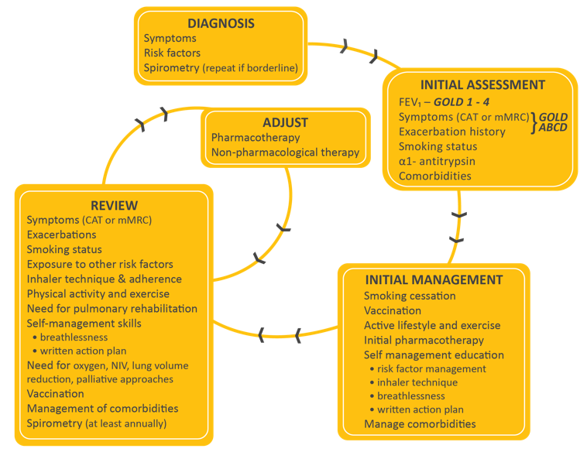
Management of COPD
CAT = COPD Assessment Test; COPD = chronic obstructive pulmonary disease; FEV₁ = forced expiratory volume in 1 second; GOLD = Global Initiative for Chronic Obstructive Lung Disease; mMRC = modified British Medical Research Council Questionnaire; NIV = noninvasive ventilation.
Global Initiative for Chronic Obstructive Lung Disease (GOLD). Global Strategy for the Diagnosis, Management, and Prevention of Chronic Obstructive Pulmonary Disease. 2021 Report. https://goldcopd.org/2021-gold-reports/. Accessed November 27, 2020.
Notes:
Notes:
COPD patients should have an assessment of the severity of their airflow obstruction, symptoms, history of exacerbations, exposure to risk factors and comorbidities to guide management.
Following assessment, initial management should address reducing exposure to risk factors including smoking cessation. Vaccinations should be offered, and patients should receive advice on healthy living. Comorbidities should also be managed.
Patients should be reviewed after a suitable interval and their current level of symptoms and exacerbation frequency assessed, along with inhaler technique, adherence to therapy, smoking status, and exposure to risk factors.
Pharmacological and non-pharmacological therapy should be adjusted as necessary.
Reference:
Global Initiative for Chronic Obstructive Lung Disease (GOLD). Global Strategy for the Diagnosis, Management, and Prevention of Chronic Obstructive Pulmonary Disease. 2021 Report. https://goldcopd.org/2021-gold-reports/. Accessed November 27, 2020.

Slide 6
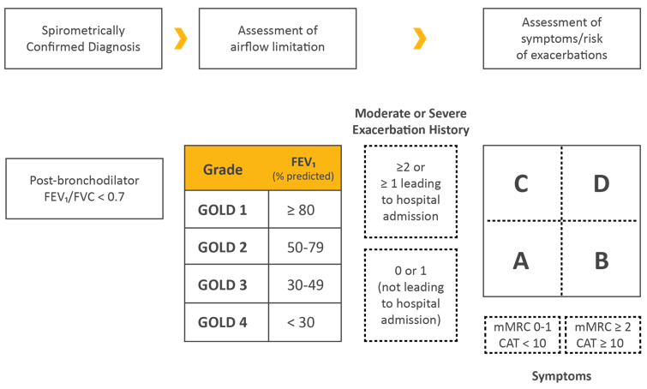
Refined ABCD Assessment Tool
CAT = COPD Assessment Test; COPD = chronic obstructive pulmonary disease; FEV₁ = forced expiratory volume in 1 second; FVC = forced vital capacity; GOLD = Global Initiative for Chronic Obstructive Lung Disease; mMRC = modified British Medical Research Council Questionnaire.
Global Initiative for Chronic Obstructive Lung Disease (GOLD). Global Strategy for the Diagnosis, Management, and Prevention of Chronic Obstructive Pulmonary Disease. 2021 Report. https://goldcopd.org/2021-gold-reports/. Accessed November 27, 2020.
Notes:
Note:
Present slide
Additional Information:
Assessment of Airflow Limitation
Spirometry is required to make the diagnosis of COPD in a clinical context
A post-bronchodilator FEV₁/FVC of <0.70 confirms the presence of persistent airflow limitation and thus COPD in patients with appropriate symptoms and significant exposures to noxious stimuli
Spirometry should be performed after administration of a short-acting bronchodilator in order to minimize variability
Assessment of Symptoms/Risk of Exacerbation
FEV₁ is an important parameter at the population-level in the prediction of important clinical outcomes. However, at the individual patient level, FEV₁ loses precision and cannot be used alone to determine all therapeutic options
In some circumstances (eg, during hospitalization, urgent care or ED visits), the ability to assess patients based on symptoms and exacerbation history, independent of the spirometric value, allows clinicians to initiate a treatment plan based on the revised ABCD scheme alone. This assessment approach acknowledges the limitations of FEV₁ in making treatment decisions and highlights the importance of patient symptoms and exacerbation risks in guiding COPD therapies
Although COPD is defined on the basis of airflow limitation, often the decision to seek medical help is determined by the impact of symptoms on the patient’s functional status
Separating airflow limitation from clinical parameters makes it clearer what is being evaluated and ranked, and facilitates more precise treatment recommendations based on the parameters that are driving the patient’s symptoms at any given time
Note to Presenter:
Choose the magnifier icon to present the slide “COPD Exacerbations: Risk Factors and Impact”
Choose the magnifier icon to present the slide “Symptom Tests”
Reference:
Global Initiative for Chronic Obstructive Lung Disease (GOLD). Global Strategy for the Diagnosis, Management, and Prevention of Chronic Obstructive Pulmonary Disease. 2021 Report. https://goldcopd.org/2021-gold-reports/. Accessed November 27, 2020.

Slide 7
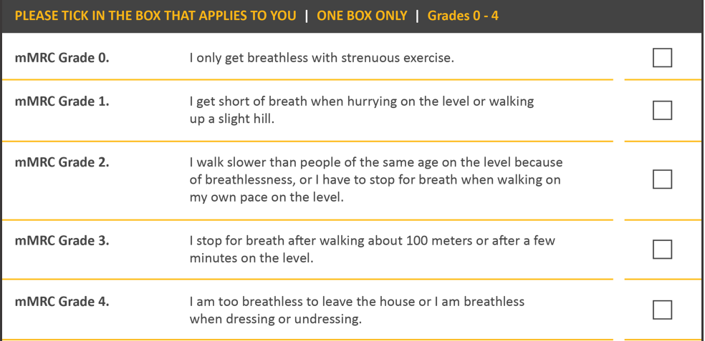
Modified MRC Dyspnea Scale^{1,2}
mMRC = modified British Medical Research Council Questionnaire.
1. Global Initiative for Chronic Obstructive Lung Disease (GOLD). Global Strategy for the Diagnosis, Management, and Prevention of Chronic Obstructive Pulmonary Disease. 2021 Report. https://goldcopd.org/2021-gold-reports/. Accessed November 27, 2020; 2. Fletcher CM. BMJ. 1960;2:1665.
Notes:
Note:
Present slide.

Slide 8
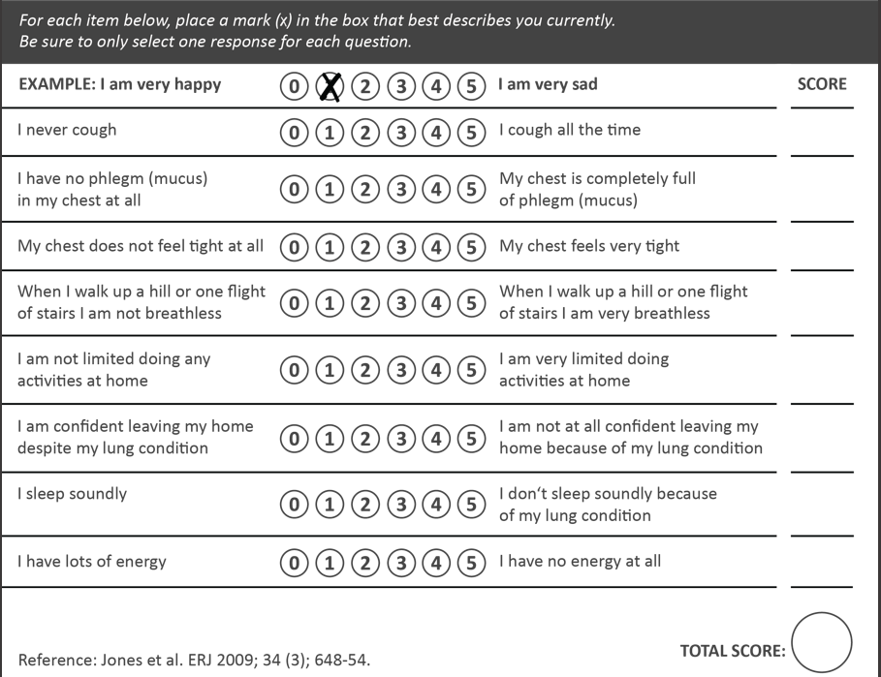
CAT™ Assessment^{1,2}
CAT = COPD Assessment Test; COPD = chronic obstructive pulmonary disease.
1. Global Initiative for Chronic Obstructive Lung Disease (GOLD). Global Strategy for the Diagnosis, Management, and Prevention of Chronic Obstructive Pulmonary Disease. 2021 Report. https://goldcopd.org/2021-gold-reports/. Accessed November 27, 2020; 2. Jones PW et al. Eur Respir J. 2009;34:648-654.
Notes:
Note:
Present slide.

Slide 9
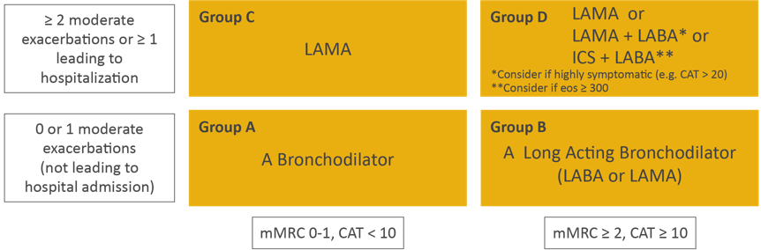
Initial Pharmacological Management of COPD
CAT™ = COPD Assessment Test; COPD = chronic obstructive pulmonary disease; eos = blood eosinophil count in cells per microliter; ICS = inhaled corticosteroid; LABA = long-acting beta₂-agonist; LAMA = long-acting muscarinic antagonist; mMRC = modified British Medical Research Council questionnaire.
Global Initiative for Chronic Obstructive Lung Disease (GOLD). Global Strategy for the Diagnosis, Management, and Prevention of Chronic Obstructive Pulmonary Disease. 2021 Report. https://goldcopd.org/2021-gold-reports/. Accessed November 27, 2020.
Notes:
Note:
Present slide
Additional Information:
Group A
All Group A patients should be offered a short or long-acting bronchodilator treatment based on its effect on breathlessness
Group B
Initial therapy should consist of a long-acting bronchodilator. Long-acting inhaled bronchodilators are superior to short-acting bronchodilators taken as needed
For patients with severe breathlessness initial therapy with two bronchodilators may be considered
Group C
Initial therapy should consist of a single long-acting bronchodilator
Two head-to-head comparisons showed LAMA was superior to LABA regarding exacerbation prevention; LAMA recommended
Group D
Therapy can be started with a LAMA
For patients with more severe symptoms (CAT™ ≥20), especially with dyspnea and/or exercise limitation, LAMA/LABA may be chosen as initial treatment.
In some patients, initial therapy with LABA/ICS may be the first choice; this treatment has the greatest likelihood of reducing exacerbations in patients with blood eosinophil counts ≥300 cells/µL. LABA/ICS may be the first choice in patients with a history of asthma
ICS may cause side effects such as pneumonia so should be used as initial therapy only after the possible clinical benefits versus risks have been considered
Reference:
Global Initiative for Chronic Obstructive Lung Disease (GOLD). Global Strategy for the Diagnosis, Management, and Prevention of Chronic Obstructive Pulmonary Disease. 2021 Report. https://goldcopd.org/2021-gold-reports/. Accessed November 27, 2020.

Slide 10
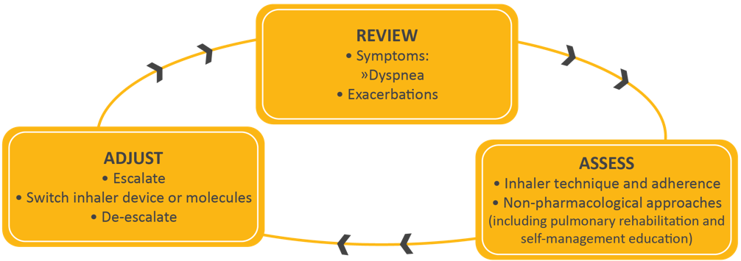
Treatment of Stable COPD: Management Cycle
Patients, in whom treatment modification is considered, in particular de-escalation, should be undertaken under close medical supervision.
COPD = chronic obstructive pulmonary disease; ICS = inhaled corticosteroid.
Global Initiative for Chronic Obstructive Lung Disease (GOLD). Global Strategy for the Diagnosis, Management, and Prevention of Chronic Obstructive Pulmonary Disease. 2021 Report. https://goldcopd.org/2021-gold-reports/. Accessed November 27, 2020.
Notes:
Notes:
Review symptoms (dyspnea) and exacerbation risk
Assess inhaler technique and adherence, and consider non-pharmacological approaches
Adjust pharmacological treatment, including escalation or de-escalation. Switching inhaler device or molecules within the same class may be appropriate
Note to Presenter:
Choose the magnifier icon to present the slide “The GOLD Report Discusses Inhaled Drug Delivery”
Reference:
Global Initiative for Chronic Obstructive Lung Disease (GOLD). Global Strategy for the Diagnosis, Management, and Prevention of Chronic Obstructive Pulmonary Disease. 2021 Report. https://goldcopd.org/2021-gold-reports/. Accessed November 27, 2020.

Slide 11
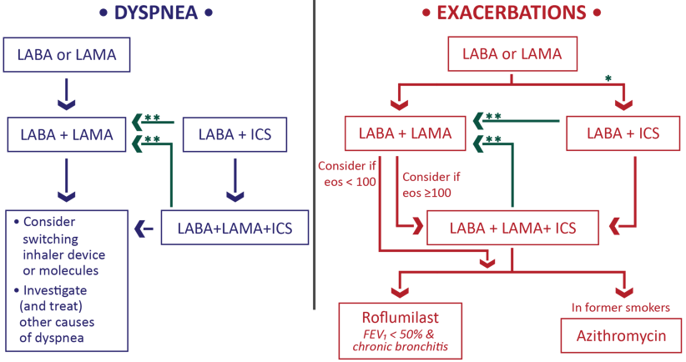
Treatment of Stable COPD: Follow-up Pharmacologic Treatment
If response to initial treatment is appropriate, maintain it.
If not:
  Consider the predominant treatable trait to target (dyspnea or exacerbations)
      Use exacerbation pathway if both exacerbations and dyspnea need to be targeted
  Place patient in box corresponding to current treatment & follow indications
  Assess response, adjust and review
  These recommendations do not depend on the ABCD assessment at diagnosis
*Consider if eos ≥300 or eos ≥100 AND ≥2 moderate exacerbations/1 hospitalization.
**Consider de-escalation of ICS or switch if pneumonia, inappropriate original indication or lack of response to ICS.
COPD = chronic obstructive pulmonary disease; eos = blood eosinophil count (cells/μL); ICS = inhaled corticosteroid; LABA = long-acting beta₂-agonist; LAMA = long-acting muscarinic antagonist.
Global Initiative for Chronic Obstructive Lung Disease (GOLD). Global Strategy for the Diagnosis, Management, and Prevention of Chronic Obstructive Pulmonary Disease. 2021 Report. https://goldcopd.org/2021-gold-reports/. Accessed November 27, 2020.
Notes:
Note:
Present slide
Notes to Presenter:
Choose the magnifier icon to present “Considerations Regarding Other Pharmacologic Options”

